Slide 1
15. Additional class
Creating a Facebook Event
Get Noticed!

Slide 2
Why Use Facebook events?
Stated Communications
Called Communications
Special Events & Fundraisers
Training & Lodge Practices
Make sure to email special posts with images and videos to post on GL Facebook Page & in Florida Magazine (Larry Duff | ldduff@centurylink.net)

Slide 3
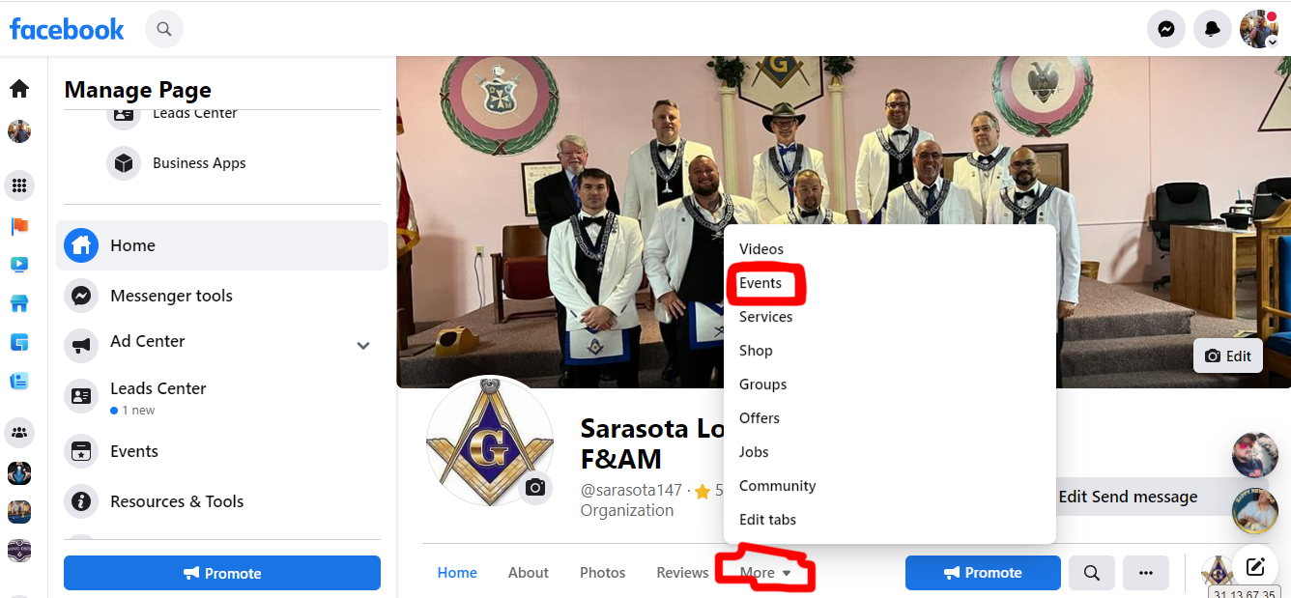
Under more or in left menu select “Events”

Slide 4
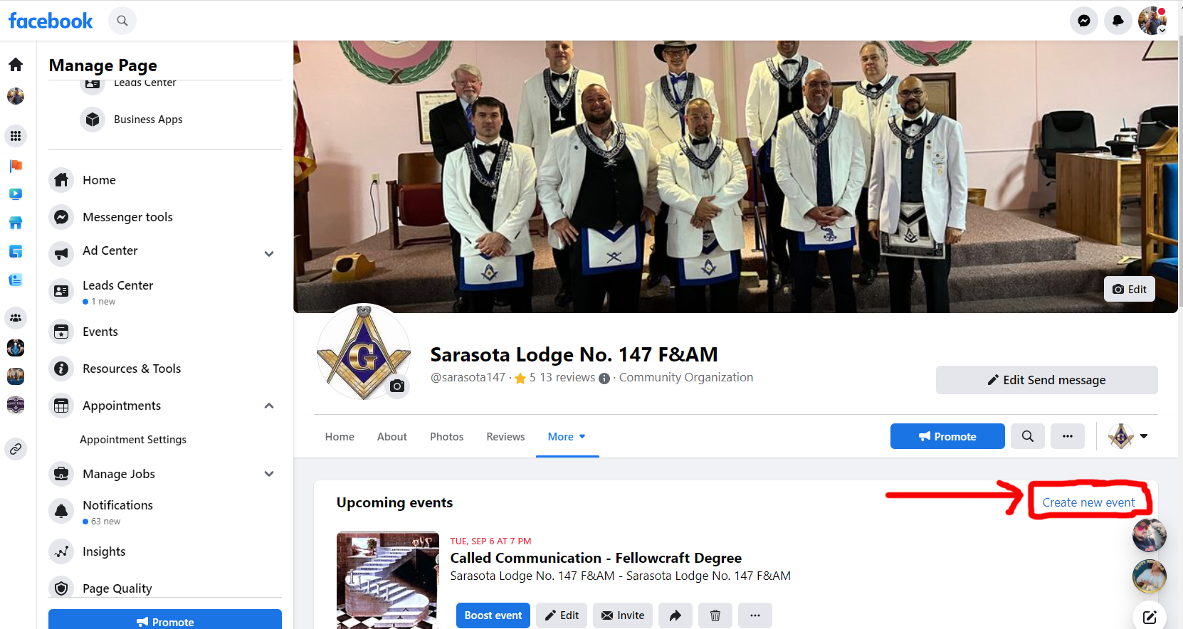
choose “Create New Event”

Slide 5
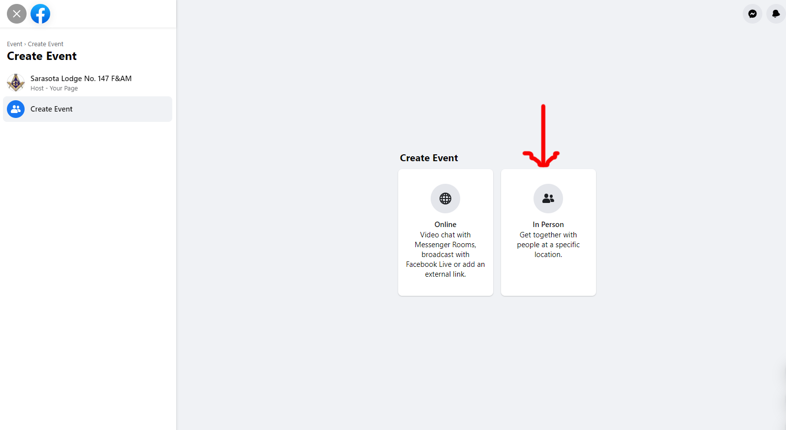
choose “In Person or Online”

Slide 6
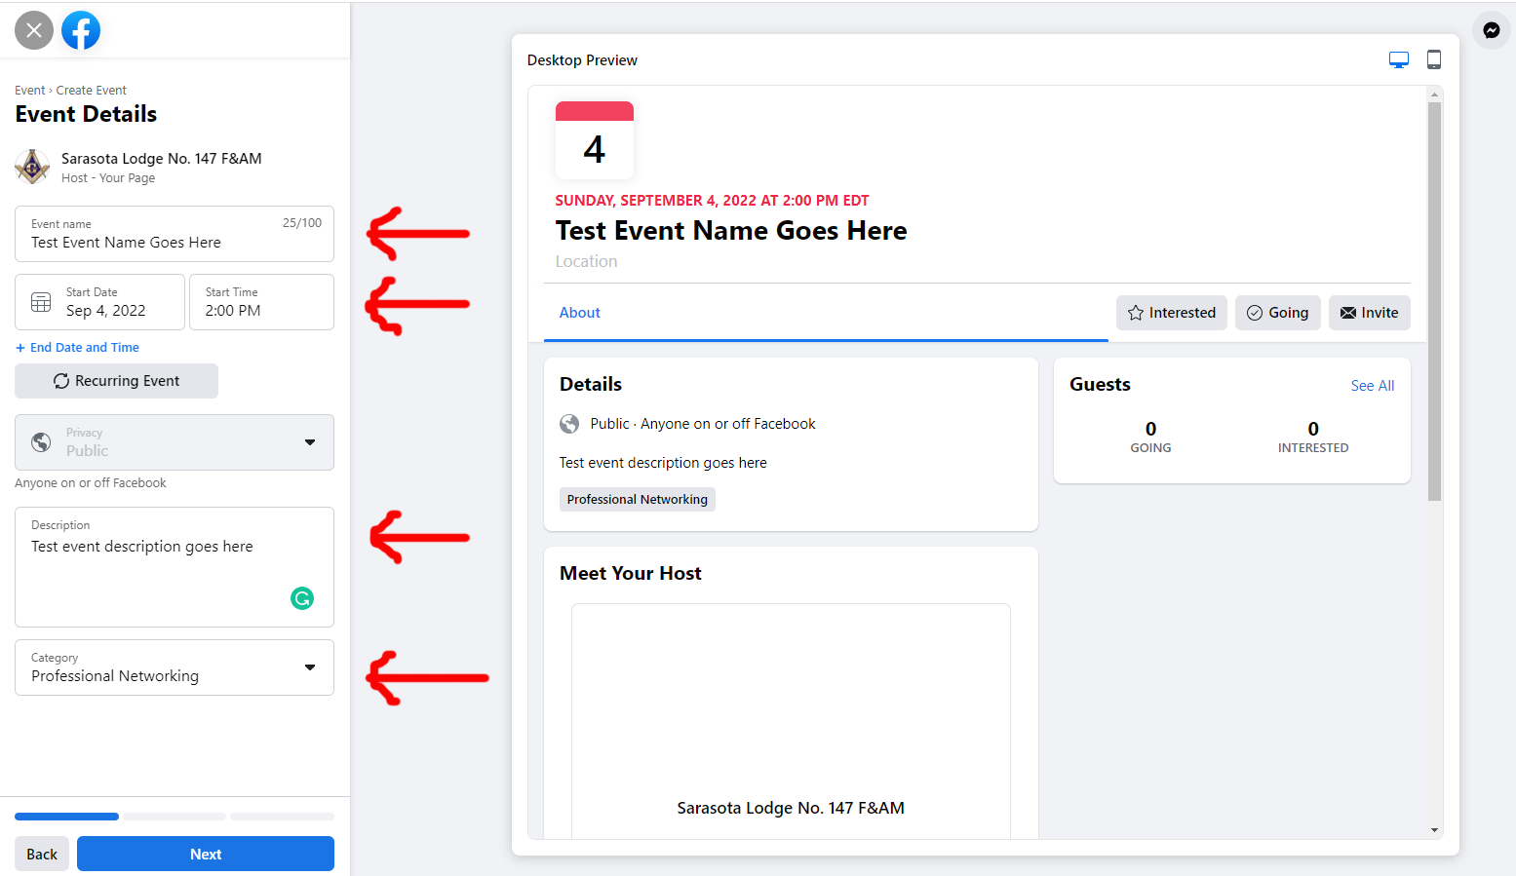
Enter “Event Name, Date, Description, & Category”

Slide 7
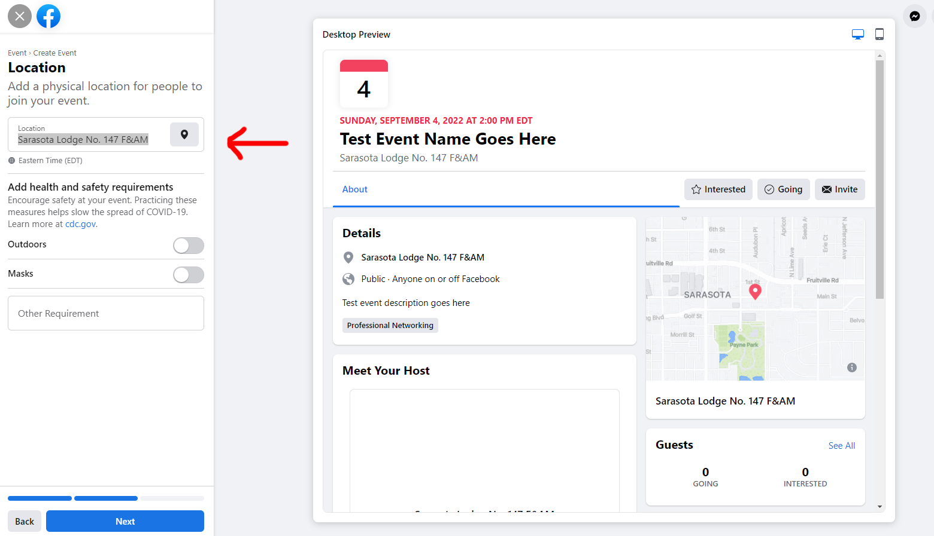
choose “Location”

Slide 8
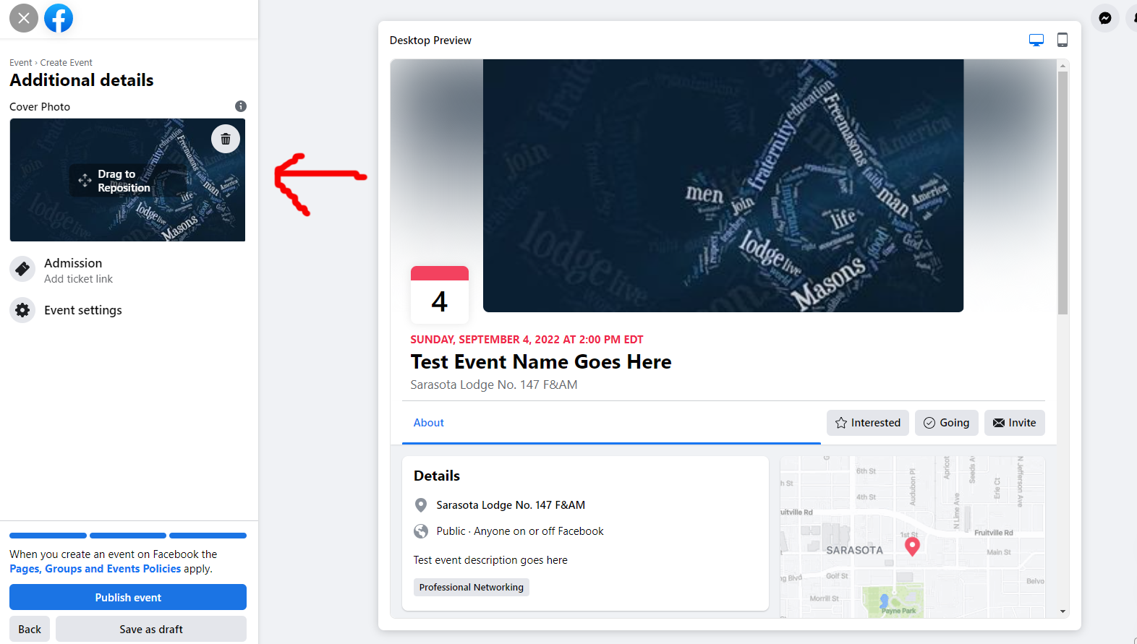
Upload “Cover Photo”

Slide 9
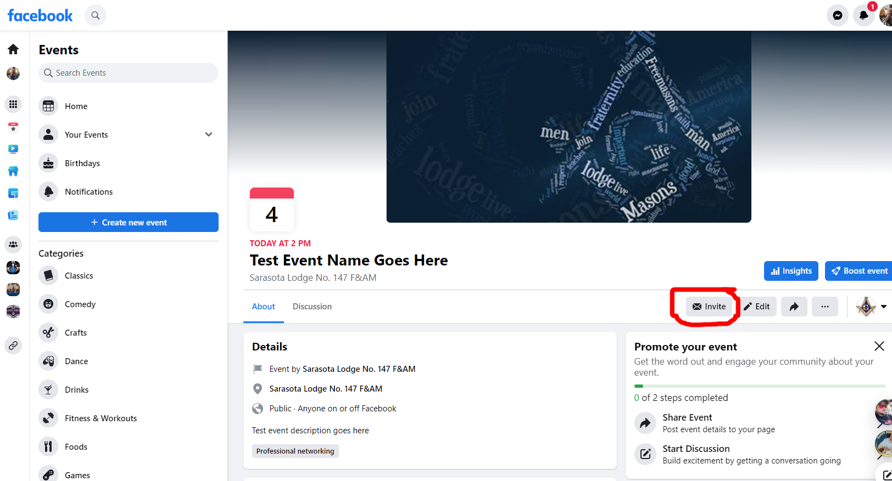
DONE! now choose “Invite”

Slide 10
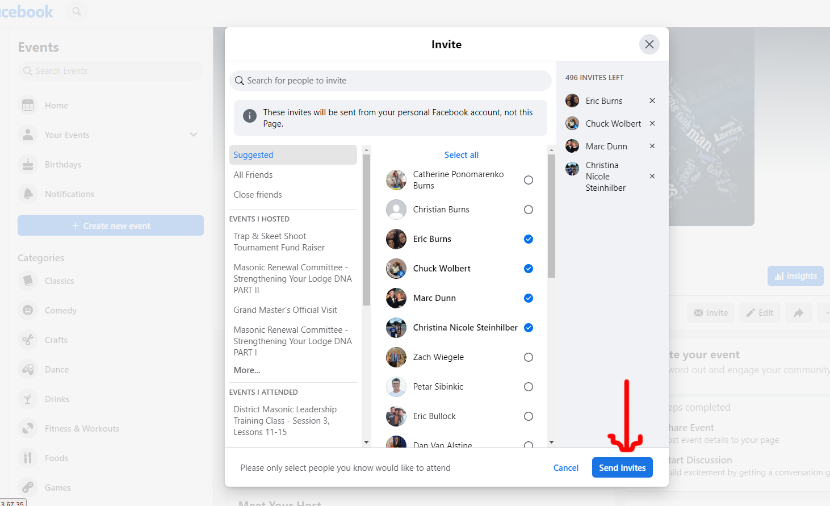
Invite friends and click “Send Invite”

